Slide 1

Category Review: Chips

Slide 2
Executive Summary
Task 1
Task 2
Conduct analysis on the client’s transaction dataset and identify any customer purchasing behaviors to generate insights and provide commercial recommendations
Look at the effect of new product layouts on purchase behavior of the client’s customers.

Slide 3
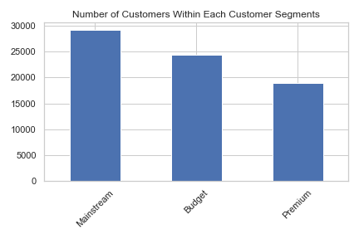
Category
Three main customer segments for the client
Most customers are mainstream, representing almost twice the number of premium customers

Slide 4
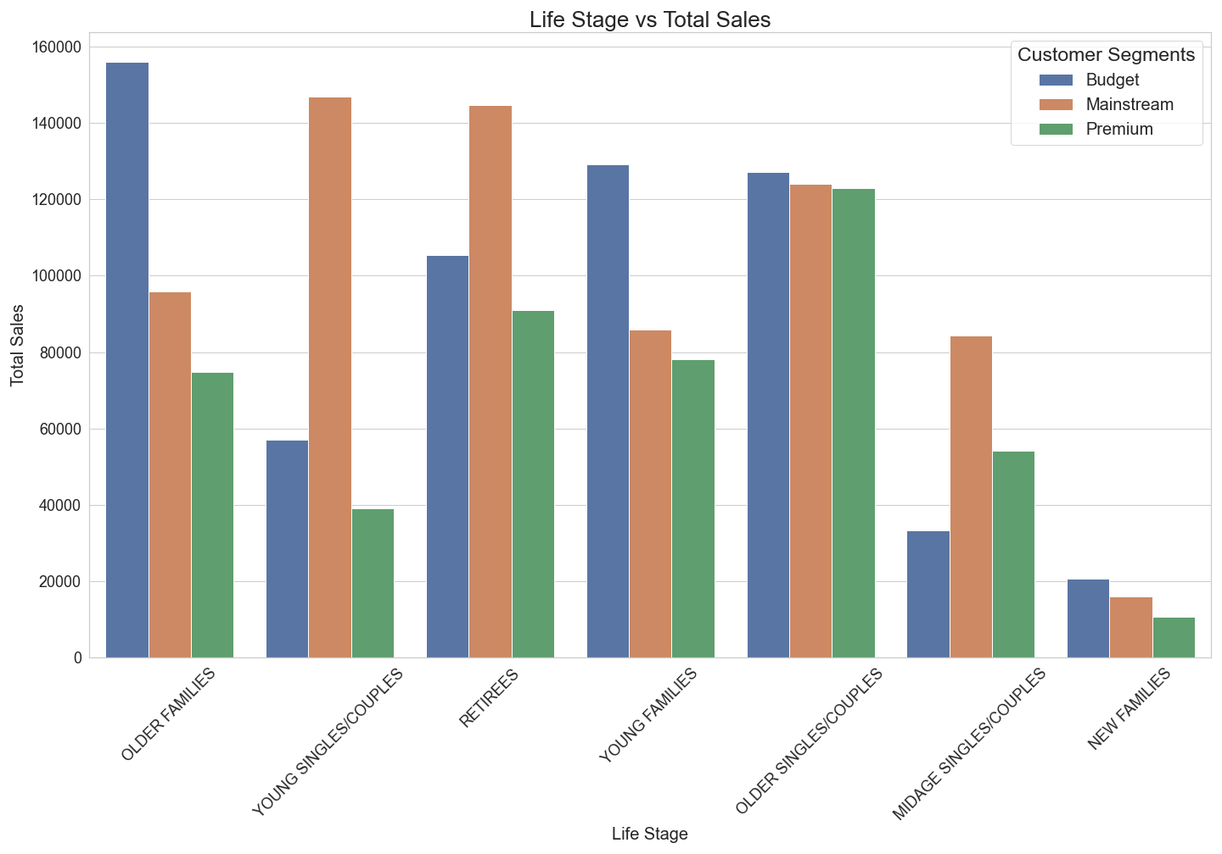
Who spend the most on Chips?
Most sales came from
Budget customers from the “older families” segment
Mainstream customers from the “young singles/couples” and “Retirees” segment

Slide 5
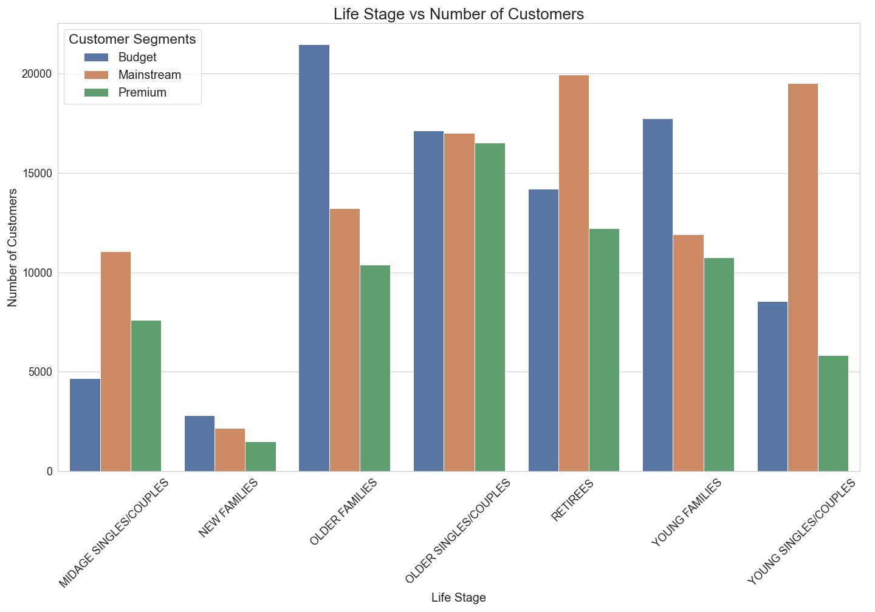
Number of Customers in Each Segment
More mainstream customers in “Young singles/couples” and “Retirees” segments
The number of Budget customers in the “Older Families segment was not a major driver of sales

Slide 6
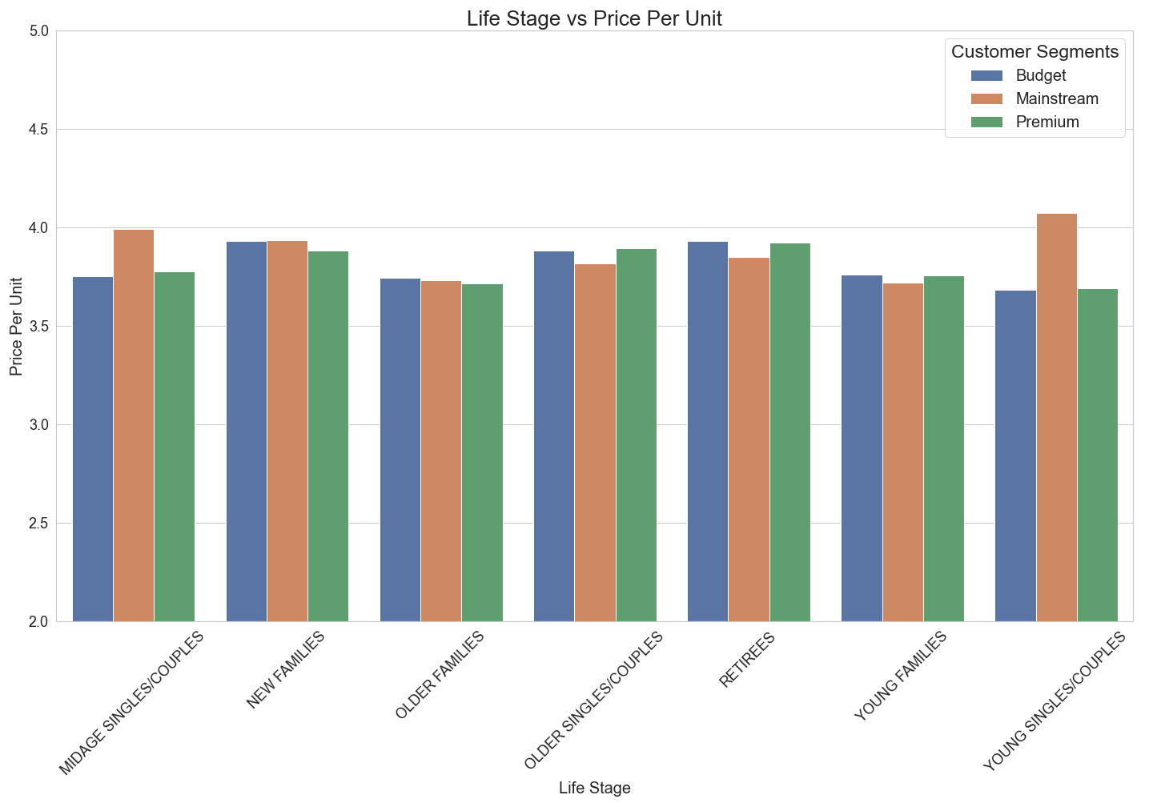
Average Price Per Unit for Each Customer Segment
Mainstream customers from the “Young singles/couples” and “Midage singles/couples” are more likely to pay more per unit

Slide 7
Mainstream Young Singles/Couples Customer Segment
Focus on Mainstream customers in the young singles/couples segment because they are one of the top contributors to sales.

Slide 8
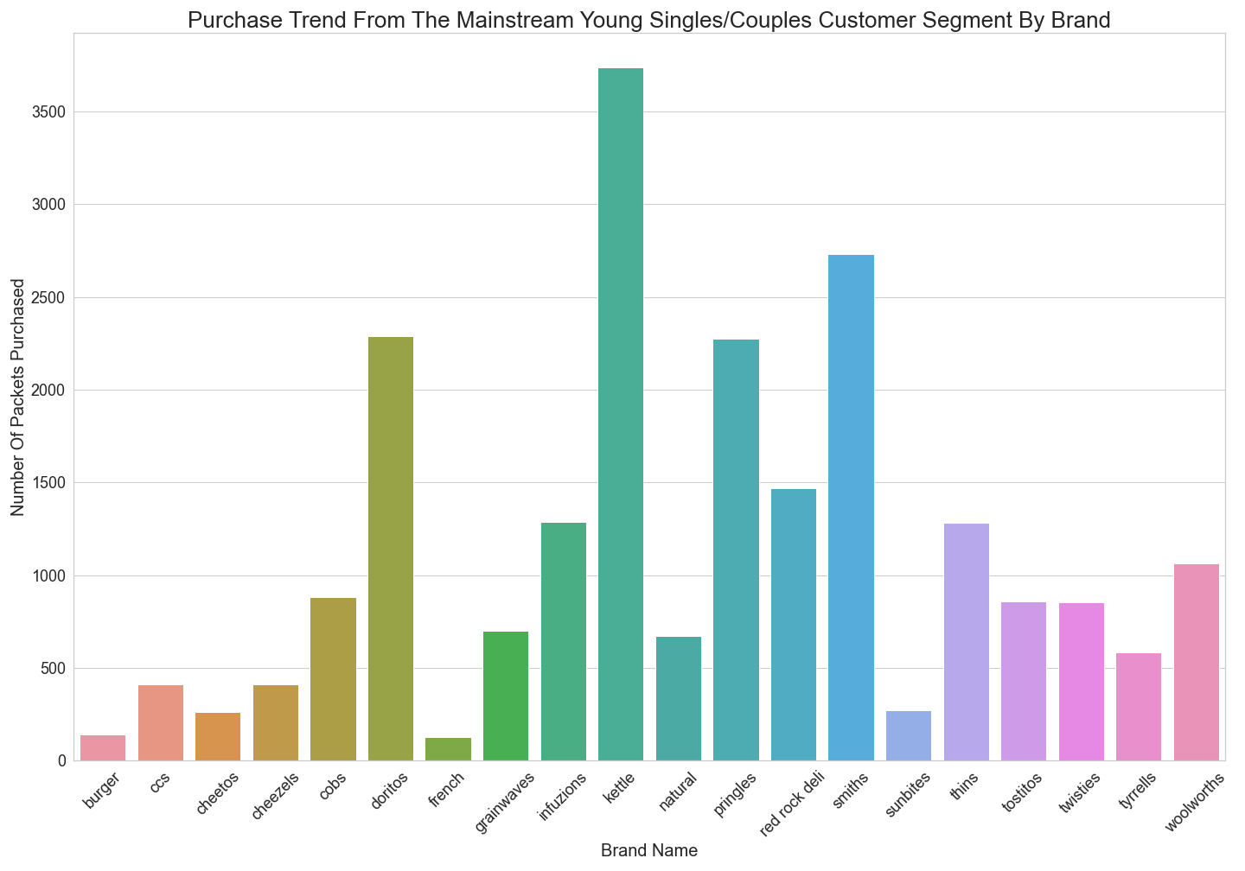
Brand Popularity Within Target Segment
Most popular brand choice of chips are:
Kettle
Smiths
Doritos

Slide 9
Trial Store vs Control Store
Client picked three trial stores 77, 86, and 88
Compare each trial store with a control store
Control stores are stores with similar characteristics with trial stores

Slide 10
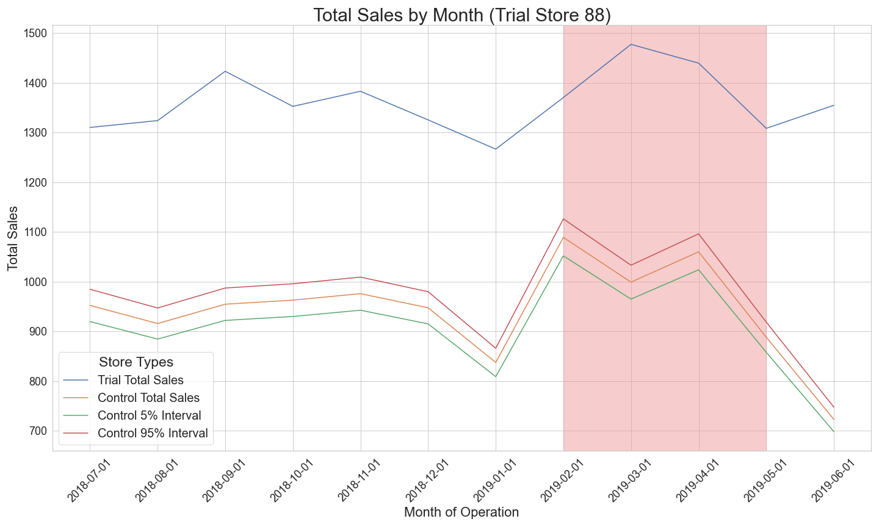
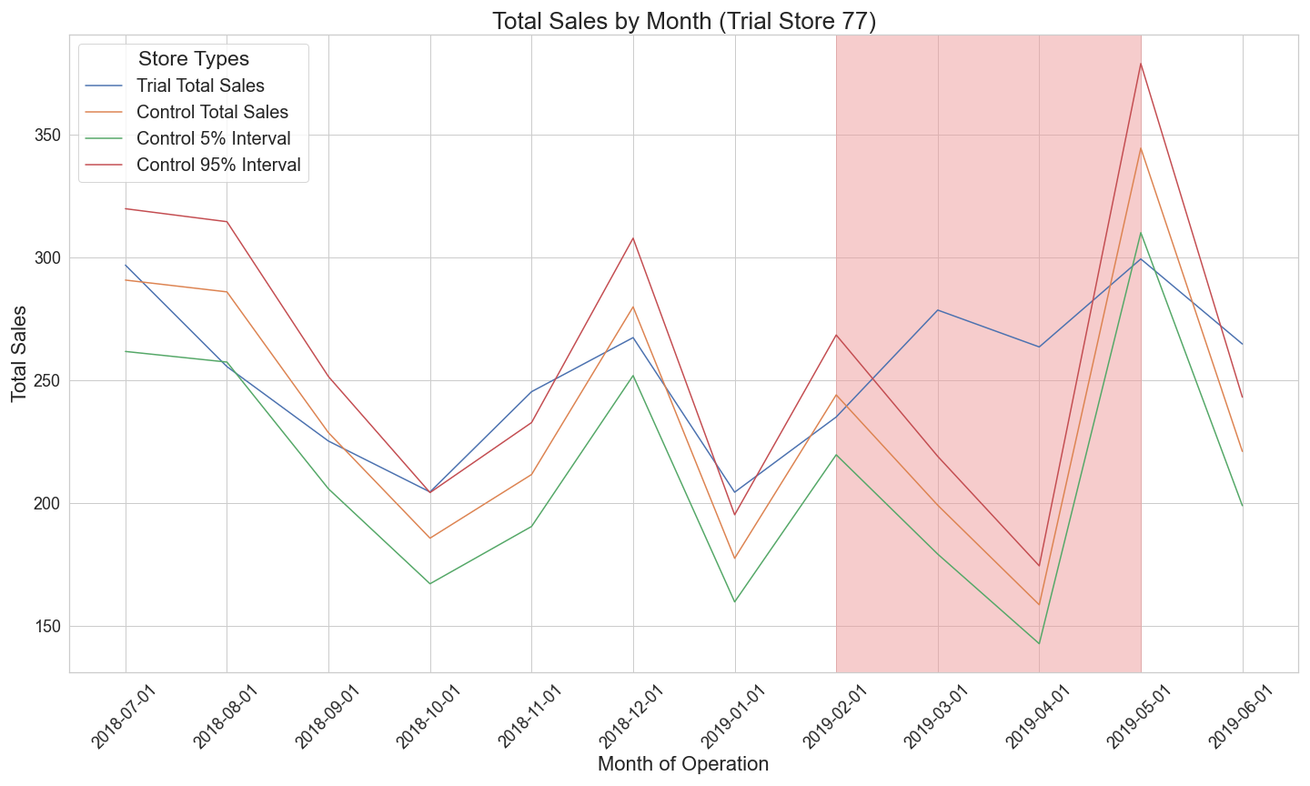

Trial store performance
Trial periods are highlighted in red on the graphs.
Trial stores in general outperform their control stores
Suggests that the new trial layouts had a positive impact on attracting customers and improve sales within the trial months

